Slide 1
State Space Search
Iftekhar Mahmud Towhid

Slide 2
State space
In the theory of discrete dynamical systems, a state space is the set of values which a process can take. For example, a system in queuing theory recording the number of customers in a line would have state space {0, 1, 2, 3, ....}.
In games, the state space is the set of all possible configurations within the game which can be reached by legal actions. For instance, in chess, it consists of all the possible board configurations. Within this state space there is the subset of configurations which are valid according to the rules of chess.

Slide 3
State space
A game's total state space is often readily calculated whereas finding the subset of valid configurations may be a considerable challenge. The size of a game's state space is related to its complexity.
For some systems, the state space can be so huge that even for the fastest computer on earth, it may take thousands of years to explore all the states.

Slide 4
State space
Here are the sizes of state space for some problems:
Problem | State space size
Theorem proving | Infinite
Chess | 10¹²⁰
Checkers | 10⁴⁰
8-puzzle | 181,440
See problem types

Slide 5
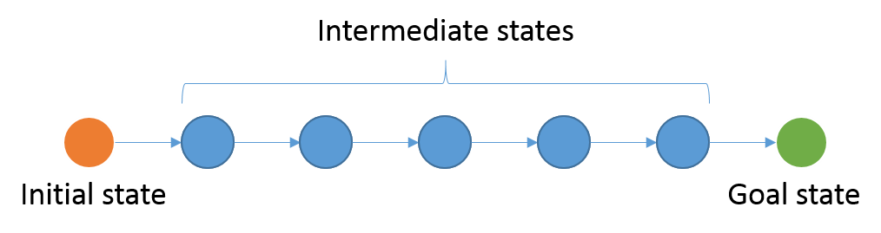
Problem solving by searching: State space search
A wide range of AI problems can be formulated as searches.
State space search is the process of searching for a sequence of actions that take from an initial state to a goal state to formulate a solution for a given problem.
Figure: State space search

Slide 6
Application
Search can be applied to many problems:
  Solution to a puzzle.
  Shortest path on a map.
  Proof of a theorem.
  Sequence of moves to win a game.
  Sequence of transformations to solve a symbolic integration problem.
  Sequence of moves to achieve a desired state.

Slide 7
State space search is an example of a weak method.
A weak method is:
  a problem-independent framework for solving problems
  It may have "stubs" for incorporating domain knowledge
However: weak methods usually cannot overcome the combinatorial explosion.

Slide 8
Formulating State Space Search
What kind of problems can we solve using state space search?
  We can discretize the underlying system into distinct state.
  We can move from one state to another state by performing some action (from a set of valid actions)

Slide 9
Formulating State Space Search
S1
S3
The underlying state space is a Graph –
G = (S, A)
Where,
  S = Set of States
  A = Set of Actions
We also have a partial function ρ: S × A → S, that tells you for each state, which actions will take you to which states.
a1
a1
a3
a3
S2
S4
a2
a2
a3
S6
a1
S5

Slide 10
Formulating state space search
State space search can be applied for those systems which have a set of distinct states, and the system can go from one state to another by applying an action/operator from a set of legal actions/operators. The search is started from a given initial state and run until a desired goal state is reached.
Simply, a state space search is represented by:
  A set of states: the state space.
  An initial state.
  A set of operators/actions
  A set of goal states, or a single goal state
  An optional path cost function

Slide 11
Types of State Space Search Problems
We can classify by whether we are given any initial state to search our start
With initial state
  Path finding problem (Also known as route finding problem)
    The problem P = (S, A, Si, Sg, ρ)
  Path with least cost problem
    The problem P = (S, A, Si, Sg, ρ, P: S × (A × S)* )
Without any initial state
  Goal finding problem
    Constraint Satisfaction Problem

Slide 12
Formal representation of State Space Search Problem
In summary, A problem is a tuple (S, s, A, ρ, G, P), where -
  S is a set of states
  s ∈ S is the initial state
  A is a set of actions (sometimes called operators)
  ρ: S × A → S, is a partial function, that tells you for each state, which actions will take you to which states.
  G: S → bool, is the goal test function, which tells you whether a state is a goal state or not.
  P: S × (A × S)* → real, is the path cost function. A path is a sequence {s₀ a₁ s₁ a₂ ...a_{k} s_{k+1} } such that ∀i ∈ {1..k}, ρ(s_{i-1}, a_{i}) = s_{i}.
  Usually, but not always, this is the sum of the "step costs" assigned by a simpler step cost function (of type S × A × S → real).
S₀
a₁
S₁
a₂
S₂
a_{k}
S_{k}

Slide 13
Formal representation of State Space Search Problem
The task is to find:
  a sequence of operators that leads from the initial state to a goal state
Goal finding problem | Reach a/the goal state starting from the initial state
Path / Route finding problem | Find a path from the initial state to the goal state
Minimum path cost | Find the path with least cost from the initial state to the goal state
Local search problem | Find a goal state that meets a certain criteria. We are not interested in the state the search starts from, or the path taken to find the goal state

Slide 14
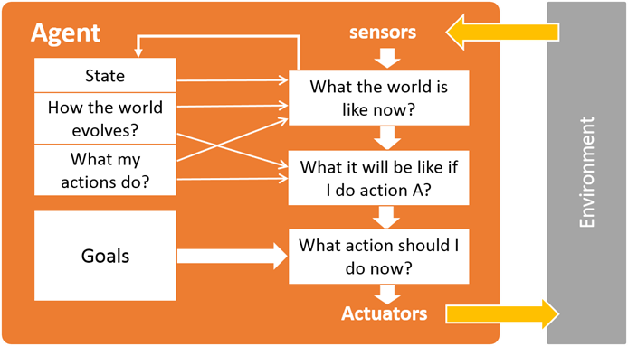
The search agent
An agent that tries to come up with a sequence of actions that will bring the environment into a desired state is called the search agent. Generally, the search agent is a goal-based agent.
Figure: a goal-based agent

Slide 15
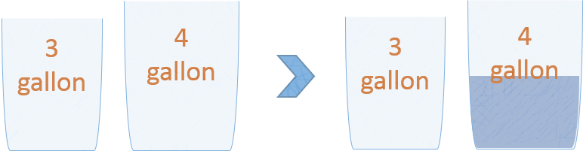
Some Classical search problems
The water-jug problem
  Suppose you are given two jugs with no measuring marks, a 3-gallon one and a 4-gallon one. There is a pump to fill the jugs with water. How can you get exactly 2 gallons of water into the 4-gallon jug?

Slide 16
Formulating water-jug problem as a state space search problem
State representation: We can represent the states as (m, n) where m and n represents the current amount of water in jug 1 and 2 respectively. m ∈ {0, 1, 2, 3} and n ∈ {0, 1, 2, 3, 4}.
Initial state: The initial state is (0, 0).
Goal state: The goal state is (x, 2); x ∈ {0, 1, 2, 3}
Actions: There are three actions we can apply to any of the jugs: fill, empty and pour from one jug to another.
Path cost: No path cost function for this problem.

Slide 17
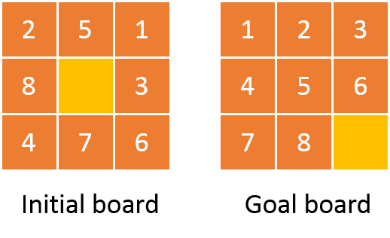
The 8-puzzle problem
The 8-puzzle is a square board with 9 positions, filled by 8 numbered tiles and one gap. At any point, a tile adjacent to the gap can be moved into the gap, creating a new gap position. In other words the gap can be swapped with an adjacent (horizontally and vertically) tile. The objective in the game is to begin with an arbitrary configuration of tiles, and move them so as to get the numbered tiles arranged in ascending order either running around the perimeter of the board or ordered from left to right, with 1 in the top left-hand position. An example scenario is shown.

Slide 18
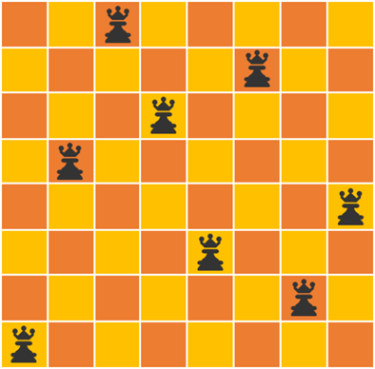
N-Queen or 8-Queen problem
Place N queens in a N × N chessboard so that no queen can attack another.

Slide 19
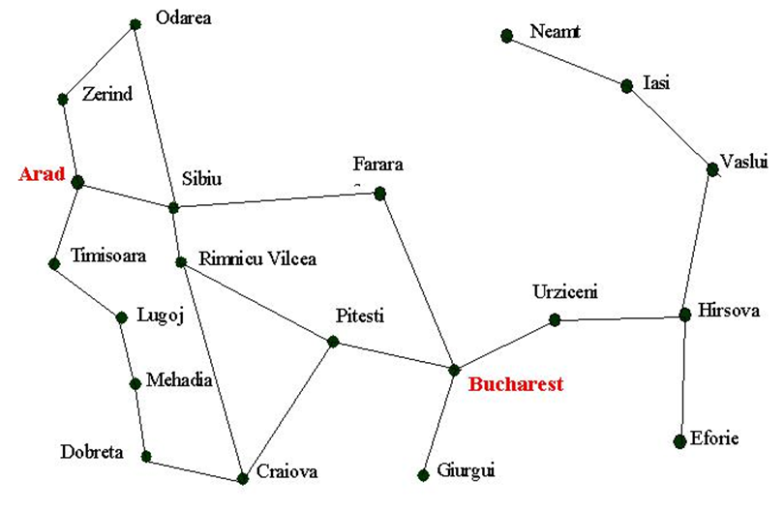
Route finding problem
Find the quickest route from Arad to Bucharest.

Slide 20
More examples
Puzzles: Rubik’s Cube, Towers of Hanoi etc.
Detecting bugs in software and hardware.
Solitaire games (FreeCell ...).
Non-player-characters in computer games.
Travelling Salesman Problem (TSP)
Robot assembly sequencing: Planning of the assembly of complex objects.
Attack planning: Finding a hack into a secured network. Used for regular security testing
Query optimization in databases.
Sequence alignment in Bioinformatics.
And many more...

Slide 21
Toy Problems versus Real-world problems
Most of the problems we will work on will be toy problems:
  Puzzle-solving (8, 15-puzzle)
  8-queens
  Cryptarithmetic
But in fact, these techniques are used to solve Real problems:
  Route-finding in airline travel planners
  Travelling Salesperson Problem
  VLSI layout (cell layout and channel routing)
  Automatic manufacturing (assembly sequencing)

Slide 22
Problem types
There are basically three types of search problems.
  Representation problems: Only need a representation of the system in a desired state, e.g. crossword puzzles.
  Goal finding problems: We only know the properties that a goal state should have, but we don't even know if any goal states exist. We just need to find a state that satisfies certain constraints for being a goal state. We don't care what action sequence gets us there. In these problems, optimality is concerned with the "best state". Examples: N-queens, integrated circuit layout and most other kinds of optimization problems.
  Action sequence finding problems: We know the state space in advance. We know which states are goals. We have to find the sequence of actions that get us to a goal state. In these problems, optimality is concerned with "cheapest path". Examples: mathematical theorems, Towers of Hanoi, 8 puzzle, water-jug problem and many other robotics problems.

Slide 23
What You Should Know
Most problem solving tasks may be formulated as state space search.
Mathematical representations for search are graphs and search trees.
Depth-first and breadth-first search may be framed, among others, as instances of a generic search strategy.
Cycle detection is required to achieve efficiency and completeness.

